Slide 1
Pathway analysis of RFS and SNP interaction on T2D survival time
BIBS Lab
Chanhwa Lee

Slide 2
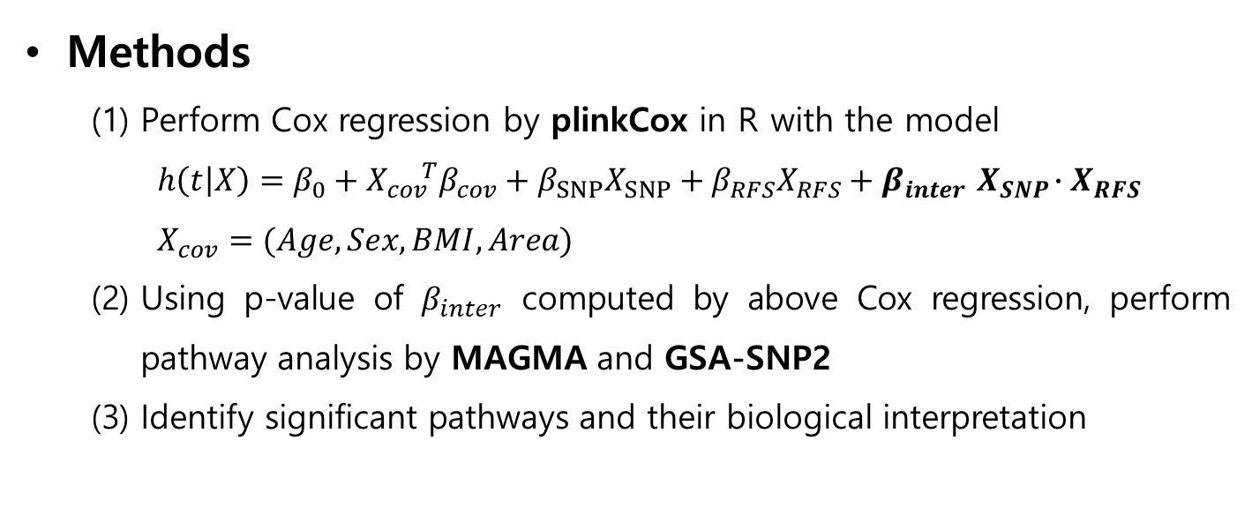
Objective
Identify SNPs, genes, and pathways having significant interaction effect with (modified)RFS on T2D survival time.
Significant interaction implies that RFS level can affects mechanism of the pathway.
Unlike previous studies, focused on “survival time” rather than incidence and “interaction effect” between RFS and SNP rather than main effect
Methods
Perform Cox regression by plinkCox in R with the model
$$h\left(t | X\right)=β_{0}+X_{cov}^{ T}β_{cov}+β_{SNP}X_{SNP}+β_{RFS}X_{RFS}+β_{inter}{ X}_{SNP}{∙X}_{RFS}$$
$$X_{cov}^{ }{=(Age, Sex, BMI, Area)}_{}$$
Using p-value of $β_{inter}$ computed by above Cox regression, perform pathway analysis by MAGMA and GSA-SNP2
Identify significant pathways and their biological interpretation

Slide 3
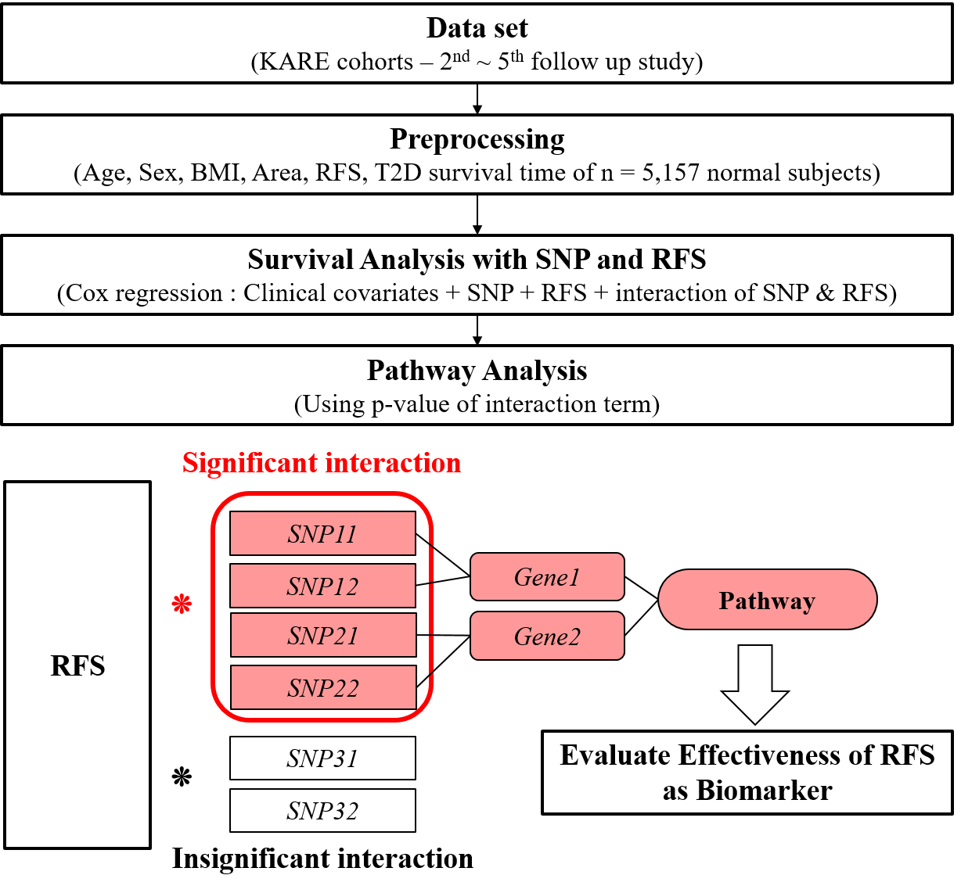

Slide 4
Methods : Sample filtering for Survival Analysis
: The second follow-up (2005-2006) of KARE were recruited.
STEP | Remaining number | Filtered out
2nd follow-up sample | n = 7,078
Subjects without information of adjusting factors eliminated ¹⁾ | n = 6,489 | 589
Subjects without information of T2D or having T2D eliminated | n = 6,252 | 237
Subjects who were diagnosed with cancer and cardiovascular diseases eliminated | n = 5,207 | 1,045
Subjects having error in examination and T2D diagnosed date eliminated | n = 5,157 | 50
¹⁾ income, alcohol, coffee, education, METs(metabolic equivalents) ^{a)}
^{a)} METs(metabolic equivalents) variable is considered according to Soo Jin Yang at el. (2018)’s study, Serum metabolite profile associated with incident type 2 diabetes in Koreans: findings from the Korean Genome and Epidemiology Study

Slide 5
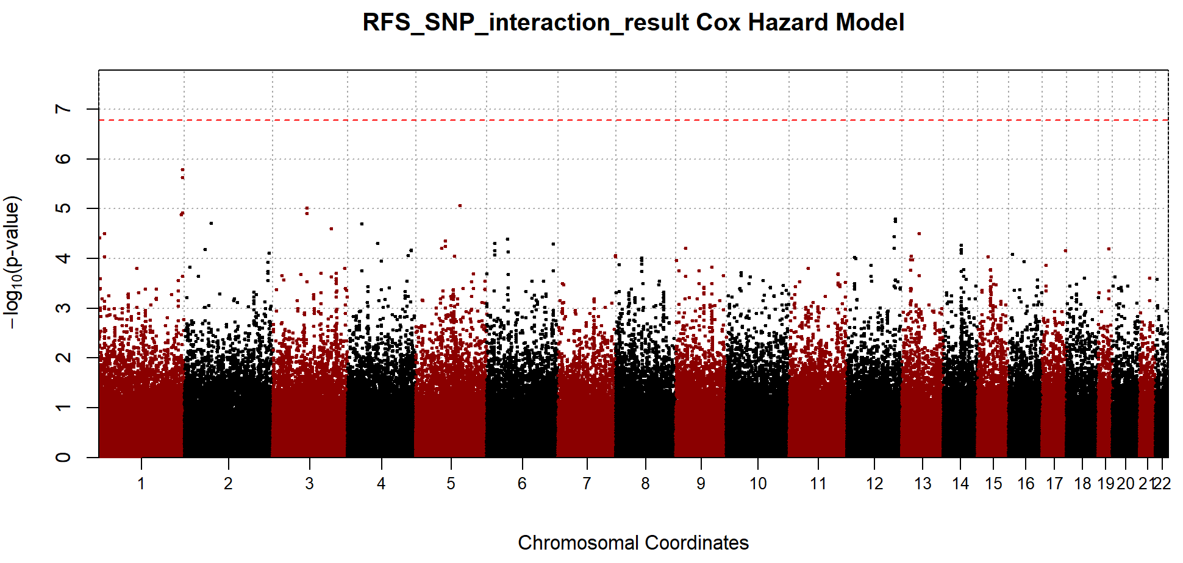
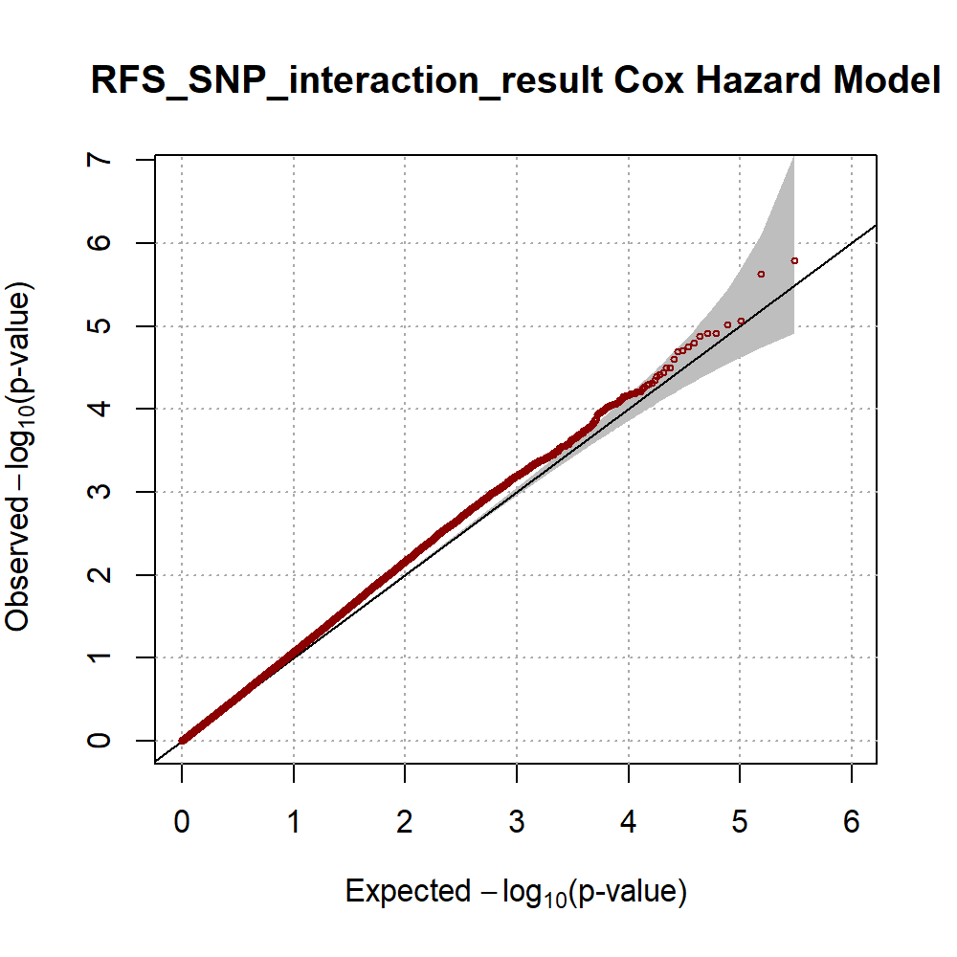
Results : Cox regression and p-value of interaction
P-value of interaction | Number of SNPs
< 10^-6 | 0
< 10^-5 | 4
< 10^-4 | 49
< 10^-3 | 489
< 0.01 | 4334
< 0.05 | 18705
< 0.1 | 35388

Slide 6
Results (Pathway Analysis)
Results : MAGMA with SNPs p-value < 0.001
†
Pathway | NGENES | P | FDR
KEGG_O_GLYCAN_BIOSYNTHESIS | 2 | 0.000614 | 0.011673
KEGG_REGULATION_OF_ACTIN_CYTOSKELETON | 3 | 0.004409 | 0.041888
KEGG_FOCAL_ADHESION | 2 | 0.027012 | 0.171076
19 pathways were matched from KEGG DB,
2 pathways were detected with 0.05 FDR criterion
Results : GSA-SNP2 with SNPs p-value < 0.001
Pathway | NGENES | P | FDR
No pathway matched
† Tables show matched pathways with p-value < 0.05

Slide 7
Results : MAGMA with SNPs p-value < 0.01
Pathway | NGENES | P | FDR
KEGG_O_GLYCAN_BIOSYNTHESIS | 4 | 1.64E-05 | 0.001722
KEGG_TYPE_I_DIABETES_MELLITUS | 2 | 0.00097334 | 0.0511
KEGG_B_CELL_RECEPTOR_SIGNALING_PATHWAY | 3 | 0.0045506 | 0.159271
KEGG_MTOR_SIGNALING_PATHWAY | 2 | 0.034965 | 0.52266
KEGG_RNA_DEGRADATION | 2 | 0.036656 | 0.52266
KEGG_GLYCOSAMINOGLYCAN_DEGRADATION | 2 | 0.041077 | 0.52266
KEGG_ALDOSTERONE_REGULATED_SODIUM_REABSORPTION | 5 | 0.041789 | 0.52266
105 pathways were matched from KEGG DB,
2 pathways were detected with 0.05 FDR criterion
Results : GSA-SNP2 with SNPs p-value < 0.01
Pathway | NGENES | P | FDR
KEGG_LONG_TERM_DEPRESSION | 10 | 0.010921 | 0.283956
KEGG_CALCIUM_SIGNALING_PATHWAY | 17 | 0.022298 | 0.28987
KEGG_GAP_JUNCTION | 11 | 0.032352 | 0.28987
26 pathways were matched from KEGG DB,
0 pathways were detected with 0.05 FDR criterion

Slide 8
Results : MAGMA with SNPs p-value < 0.05
Pathway | NGENES | P | FDR
KEGG_BLADDER_CANCER | 3 | 0.001084 | 0.118085
KEGG_NON_SMALL_CELL_LUNG_CANCER | 10 | 0.002104 | 0.118085
KEGG_MELANOMA | 11 | 0.002214 | 0.118085
KEGG_TGF_BETA_SIGNALING_PATHWAY | 11 | 0.006236 | 0.189216
KEGG_RETINOL_METABOLISM | 2 | 0.008111 | 0.189216
KEGG_TRYPTOPHAN_METABOLISM | 8 | 0.009103 | 0.189216
KEGG_THYROID_CANCER | 6 | 0.009863 | 0.189216
KEGG_FC_GAMMA_R_MEDIATED_PHAGOCYTOSIS | 18 | 0.011281 | 0.189216
KEGG_GLYCOSPHINGOLIPID_BIOSYNTHESIS_GLOBO_SERIES | 3 | 0.011469 | 0.189216
KEGG_GLYCOSAMINOGLYCAN_BIOSYNTHESIS_HEPARAN_SULFATE | 7 | 0.011826 | 0.189216
KEGG_REGULATION_OF_ACTIN_CYTOSKELETON | 35 | 0.01373 | 0.199709
KEGG_ENDOMETRIAL_CANCER | 8 | 0.017578 | 0.234373
KEGG_DORSO_VENTRAL_AXIS_FORMATION | 4 | 0.019878 | 0.244652
KEGG_GLYCOSAMINOGLYCAN_DEGRADATION | 2 | 0.027949 | 0.319417
KEGG_NUCLEOTIDE_EXCISION_REPAIR | 4 | 0.030761 | 0.32284
KEGG_LYSINE_DEGRADATION | 5 | 0.032284 | 0.32284
KEGG_BUTANOATE_METABOLISM | 3 | 0.041111 | 0.386927
KEGG_GLYCOSPHINGOLIPID_BIOSYNTHESIS_LACTO_AND_NEOLACTO_SERIES | 6 | 0.048952 | 0.435129
160 pathways were matched from KEGG DB,
0 pathways were detected with 0.05 FDR criterion

Slide 9
Results : GSA-SNP2 with SNPs p-value < 0.05
Pathway | NGENES | P | FDR
KEGG_MELANOMA | 15 | 0.003422 | 0.355883
KEGG_RENAL_CELL_CARCINOMA | 10 | 0.008689 | 0.45183
KEGG_CYTOSOLIC_DNA_SENSING_PATHWAY | 11 | 0.019612 | 0.562388
KEGG_LYSINE_DEGRADATION | 10 | 0.026161 | 0.562388
KEGG_O_GLYCAN_BIOSYNTHESIS | 12 | 0.027038 | 0.562388
KEGG_TRYPTOPHAN_METABOLISM | 11 | 0.035049 | 0.596132
KEGG_PRIMARY_IMMUNODEFICIENCY | 12 | 0.041352 | 0.596132
KEGG_JAK_STAT_SIGNALING_PATHWAY | 33 | 0.045856 | 0.596132
104 pathways were matched from KEGG DB,
0 pathways were detected with 0.05 FDR criterion

Slide 10
Results : Summary (FDR < 0.05 pathways)
Interaction p-value level | Tool | Pathway | GENE # | P | FDR
<0.001 | MAGMA | KEGG_O_GLYCAN_BIOSYNTHESIS | 2 | 0.00061 | 0.011673
 |  | KEGG_REGULATION_OF_ACTIN_CYTOSKELETON | 3 | 0.00440 | 0.041888
<0.05 | MAGMA | KEGG_O_GLYCAN_BIOSYNTHESIS | 4 | 1.64E-05 | 0.001722
 |  | KEGG_TYPE_I_DIABETES_MELLITUS | 2 | 0.00097 | 0.0511

